Slide 1
Object Oriented Programming
Introduction
Lecture No. 1
Original author of the sides is Jawad Hassan, FAST-NUCES, Islamabad but slides have been modified time by time as per the requirements of the class.

Slide 2
Lecture Contents
Introduction
C++ Programming basics
Pointers
Functions
Structures
Classes (OOP basics, inheritance, …)
Operator overloading
Streams and Files
Templates and Exceptions

Slide 3
Quiz - 01
Write a program that generates the following output, using only one cout statement and proper spacing
1900 | 2135
1950 | 2235
2000 | 2335
2050 | 2435

Slide 4

Motivation
Only 1 programming course out of approx. 40 courses
Core of core of computer science
Excellent CP = Excellent chances of good job
Remember practice makes a person “perfect”.
  Same goes for programming.

Slide 5
What is a Computer?
Computer
  A device capable of performing computations and making logical decisions
Computer programs
  Sets of instructions that control a computer’s processing of data
Hardware
  Various devices comprising a computer
    Examples: keyboard, screen, mouse, disks, memory, CD-ROM, and processing units
Software
  Programs that run a computer

Slide 6
Making Software
Load into memory and start execution
Problem
Executable file
Develop Algorithm
Compile the code
Express Algorithm in the form of pseudo code or flow chart
Write algorithm in C/C++/Java … Language
Writing code in “C++” language means, we must have to follow a certain rules of “C++” language.
This is called syntax of “C++” language.

Slide 7
Making Software
Load into memory and start execution
Compiler
“Turbo C” in DOS
“gcc” or “g++” in Linux
“Visual C++” in windows
“Borland” in DOS/Windows.
Problem
Executable file
Develop Algorithm
Compile the code
Express Algorithm in the form of pseudo code or flow chart
Write algorithm in C/C++/Java … Language
Writing code in “C++” language means, we must have to follow a certain rules of “C++” language.
This is called syntax of “C++” language.

Slide 8
Basics of a Typical C++ Environment
Phases of C++ Programs:
  Edit
  Preprocess
  Compile
  Link
  Load
  Execute
Editor
Program is created in
the editor and stored
on disk.
Disk
Preprocessor
Disk
Preprocessor program
processes the code.
Compiler
Compiler creates
object code and stores
it on disk.
Disk
Linker links the object
code with the libraries,
creates a.out and
stores it on disk
Linker
Disk
Primary
Memory
Loader
Loader puts program
in memory.
Disk
.
.
.
.
.
.
Primary
Memory
CPU
CPU takes each
instruction and
executes it, possibly
storing new data
values as the program
executes.
.
.
.
.
.
.

Slide 9
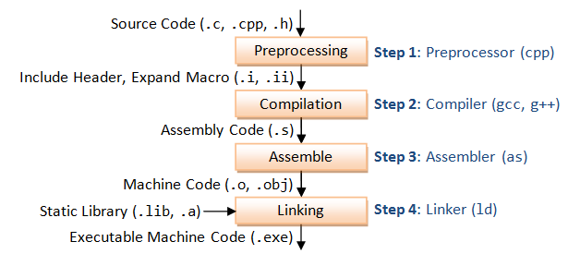
GCC Compilation Process
GCC compiles a C/C++ program into executable in 4 steps as shown in the above diagram. For example, a "gcc -o hello.exe hello.c" is carried out as follows:
Pre-processing: via the GNU C Preprocessor (cpp.exe), which includes the headers (#include) and expands the macros (#define).
> cpp hello.c > hello.i
The resultant intermediate file "hello.i" contains the expanded source code.
Compilation: The compiler compiles the pre-processed source code into assembly code for a specific processor.
> gcc -S hello.i
The -S option specifies to produce assembly code, instead of object code. The resultant assembly file is "hello.s".
Assembly: The assembler (as.exe) converts the assembly code into machine code in the object file "hello.o".
> as -o hello.o hello.s
Linker: Finally, the linker (ld.exe) links the object code with the library code to produce an executable file "hello.exe".
> ld -o hello.exe hello.o ...libraries...
Notes:
https://www3.ntu.edu.sg/home/ehchua/programming/cpp/gcc_make.html

Slide 10
Introduction to C++ Programming
C++ language
  Facilitates a structured and disciplined approach to computer program design
There are various C++ standards:
  C++98: First ISO standard
  C++11 (aka C++0x) : Major Enhancement to language and library
  C++14 (aka C++1y): Bug fixes and improvements to C++
  C++17 (aka C++1z): Library additions and Bug fixes
  C++2a (next planned standard in 202x)
Following are several examples
  The examples illustrate many important features of C++
  Each example is analyzed one statement at a time.

Slide 11
1 // Fig. 1.2: fig01_02.cpp
2 // A first program in C++
Comments
Written between /* and */ or following a //.
Improve program readability and do not cause the computer to perform any action.
3 #include <iostream>
4
5 int main()
6 {
preprocessor directive
Message to the C++ preprocessor.
Lines beginning with # are preprocessor directives.
#include <iostream> tells the preprocessor to include the contents of the file <iostream>, which includes input/output operations (such as printing to the screen).
7 std::cout << "Welcome to C++!\n";
8
9 return 0; // indicate that program ended successfully
10 }
C++ programs contain one or more functions, one of which must be main
Parenthesis are used to indicate a function
int means that main "returns" an integer value. More in Chapter 3.
Welcome to C++!
Prints the string of characters contained between the quotation marks.
The entire line, including std::cout, the << operator, the string "Welcome to C++!\n" and the semicolon (;), is called a statement.
All statements must end with a semicolon.
return is a way to exit a function from a function.
return 0, in this case, means that the program terminated normally.
A left brace { begins the body of every function and a right brace } ends it.

Slide 12
A Simple Program: Printing a Line of Text
std::cout
  Standard output stream object
  “Connected” to the screen
  std:: specifies the "namespace" which cout belongs to
    std:: can be removed through the use of using statements
<<
  Stream insertion operator
  Value to the right of the operator (right operand) inserted into output stream (which is connected to the screen)
  std::cout << “Welcome to C++!\n”;
\
  Escape character
  Indicates that a “special” character is to be output

Slide 13
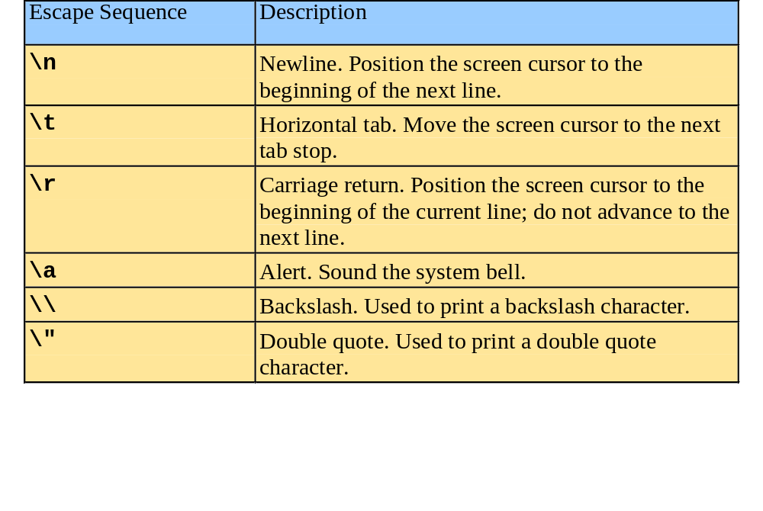
A Simple Program: Printing a Line of Text
There are multiple ways to print text
  Following are more examples

Slide 14
1 // Fig. 1.4: fig01_04.cpp
2 // Printing a line with multiple statements
3 #include <iostream>
4
5 int main()
6 {
7 std::cout << "Welcome ";
8 std::cout << "to C++!\n";
9
10 return 0; // indicate that program ended successfully
11 }
Welcome to C++!
Unless new line '\n' is specified, the text continues on the same line.

Slide 15
Another Simple Program: Adding Two Integers
Variables
  Location in memory where a value can be stored for use by a program
  Must be declared with a name and a data type before they can be used
  Some common data types are:
    int - integer numbers
    char - characters
    double - floating point numbers
  Example: int myvariable;
    Declares a variable named myvariable of type int
  Example: int variable1, variable2;
    Declares two variables, each of type int

Slide 16
Another Simple Program: Adding Two Integers
>> (stream extraction operator)
  When used with std::cin, waits for the user to input a value and stores the value in the variable to the right of the operator
  The user types a value, then presses the Enter (Return) key to send the data to the computer
  Example:
      int myVariable;
      std::cin >> myVariable;
    Waits for user input, then stores input in myVariable
= (assignment operator)
  Assigns value to a variable
  Binary operator (has two operands)
  Example:
      sum = variable1 + variable2;

Slide 17
1 // Fig. 1.6: fig01_06.cpp
2 // Addition program
3 #include <iostream>
4
5 int main()
6 {
7 int integer1, integer2, sum; // declaration
8
9 std::cout << "Enter first integer\n"; // prompt
Notice how std::cin is used to get user input.
10 std::cin >> integer1; // read an integer
11 std::cout << "Enter second integer\n"; // prompt
12 std::cin >> integer2; // read an integer
13 sum = integer1 + integer2; // assignment of sum
14 std::cout << "Sum is " << sum << std::endl; // print sum
15
16 return 0; // indicate that program ended successfully
std::endl flushes the buffer and prints a newline.
17 }
Enter first integer
45
Enter second integer
72
Sum is 117
Variables can be output using std::cout << variableName.

Slide 18
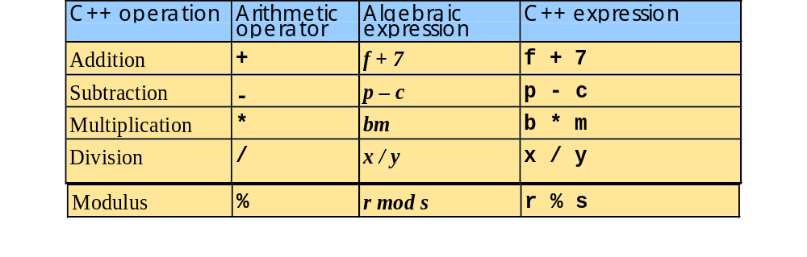
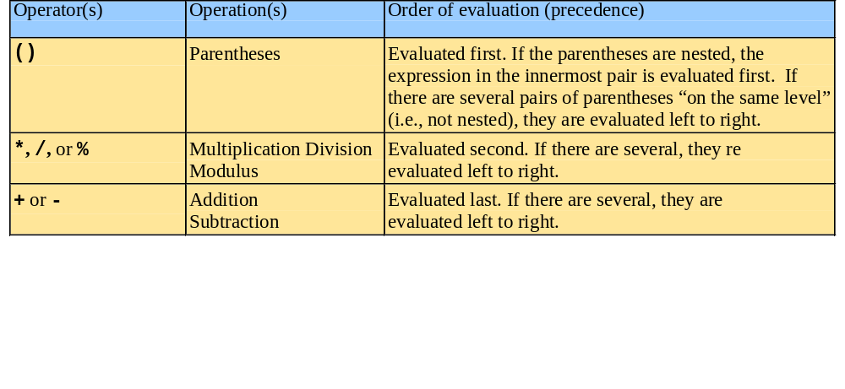
Arithmetic
Arithmetic operators:
Rules of operator precedence:

Slide 19
Decision Making: Equality/Relational Operators
using statements
  Eliminate the need to use the std:: prefix
  Allow us to write cout instead of std::cout
  To use the following functions without the std:: prefix, write the following at the top of the program
        using std::cout;
        using std::cin;
        using std::endl;

Slide 20
1 // Fig. 1.14: fig01_14.cpp
2 // Using if statements, relational
3 // operators, and equality operators
4 #include <iostream>
5
6 using std::cout; // program uses cout
Notice the using statements.
7 using std::cin; // program uses cin
8 using std::endl; // program uses endl
9
10 int main()
11 {
12 int num1, num2;
13
14 cout << "Enter two integers, and I will tell you\n"
15 << "the relationships they satisfy: ";
16 cin >> num1 >> num2; // read two integers
Enter two integers, and I will tell you
the relationships they satisfy: 3 7
17
18 if ( num1 == num2 )
19 cout << num1 << " is equal to " << num2 << endl;
The if statements test the truth of the condition. If it is true, body of if statement is executed. If not, body is skipped.
To include multiple statements in a body, delineate them with braces {}.
20
21 if ( num1 != num2 )
22 cout << num1 << " is not equal to " << num2 << endl;
3 is not equal to 7
23
24 if ( num1 < num2 )
25 cout << num1 << " is less than " << num2 << endl;
3 is less than 7
26
27 if ( num1 > num2 )
28 cout << num1 << " is greater than " << num2 << endl;
29
30 if ( num1 <= num2 )
31 cout << num1 << " is less than or equal to "
3 is less than or equal to 7
32 << num2 << endl;
33

Slide 21
34 if ( num1 >= num2 )
35 cout << num1 << " is greater than or equal to "
36 << num2 << endl;
37
38 return 0; // indicate that program ended successfully
39 }
Enter two integers, and I will tell you
the relationships they satisfy: 3 7
3 is not equal to 7
3 is less than 7
3 is less than or equal to 7
Enter two integers, and I will tell you
the relationships they satisfy: 22 12
22 is not equal to 12
22 is greater than 12
22 is greater than or equal to 12
Enter two integers, and I will tell you
the relationships they satisfy: 7 7
7 is equal to 7
7 is less than or equal to 7
7 is greater than or equal to 7

Slide 22
Expectations
Remember this is a core course.
  Quality, Extent and Depth of contents largely depends on class attitude.
  Take-up the lead yourself.
Advice on deliverables
  Start early
  Discuss progress regularly
  Make an appropriate group

Slide 23
References
Course slides – based on course slides prepared by Dr. Shariq Bashir and Dr. Uzair Khan, and Dr. Ehatsham CP Spring 2011-2012.
Text Books:
  “Object Oriented Programming in C++”, Author (s): Robert Lafore.
  “C++ How to program”, Author (s): M. Deitel & Dietel.
  “Turbo C Programming”, Author (s): Robert Lafore.

Slide 24
Questions?

